Slide 1
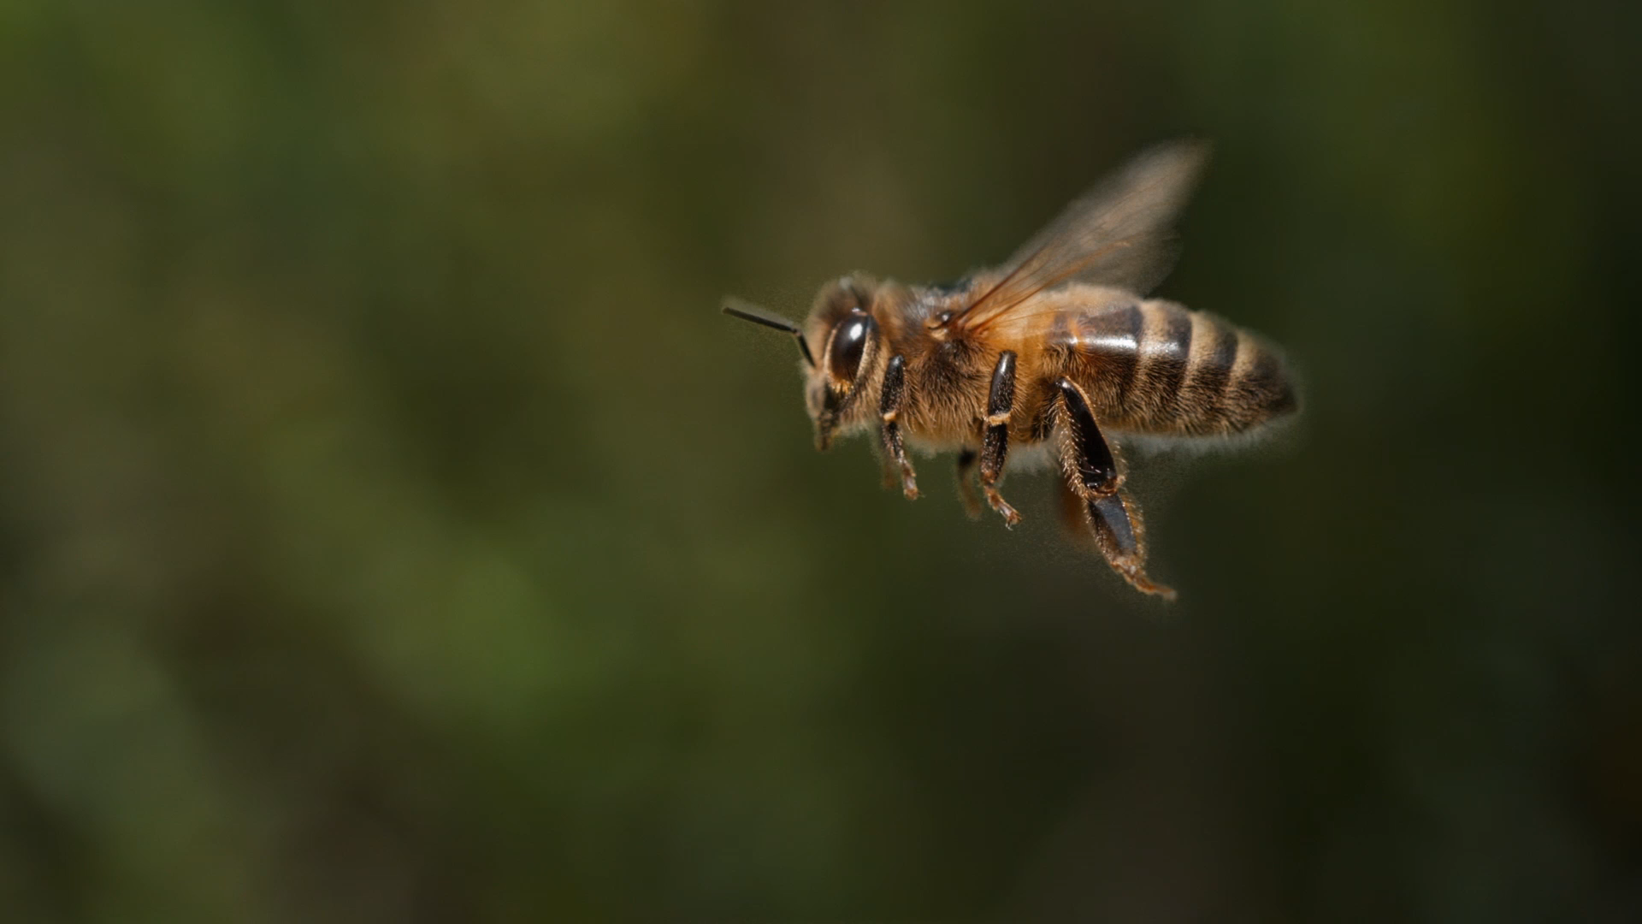

Insect Identification System
Team Tropicana
(Ashwin Rajasankar)

Slide 2
Overview
Introduction
Why?
Who?
How?
Use Case Diagram
Activity Diagram
Gantt Chart

Slide 3
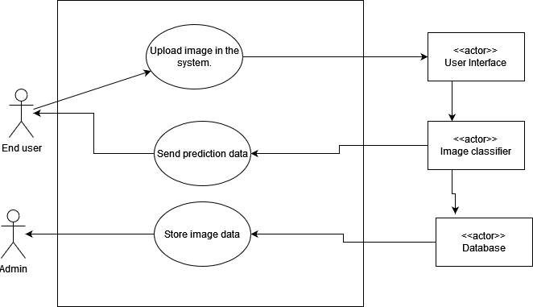
Introduction
An application to identify insects using image processing.
Created using Python.

Slide 4
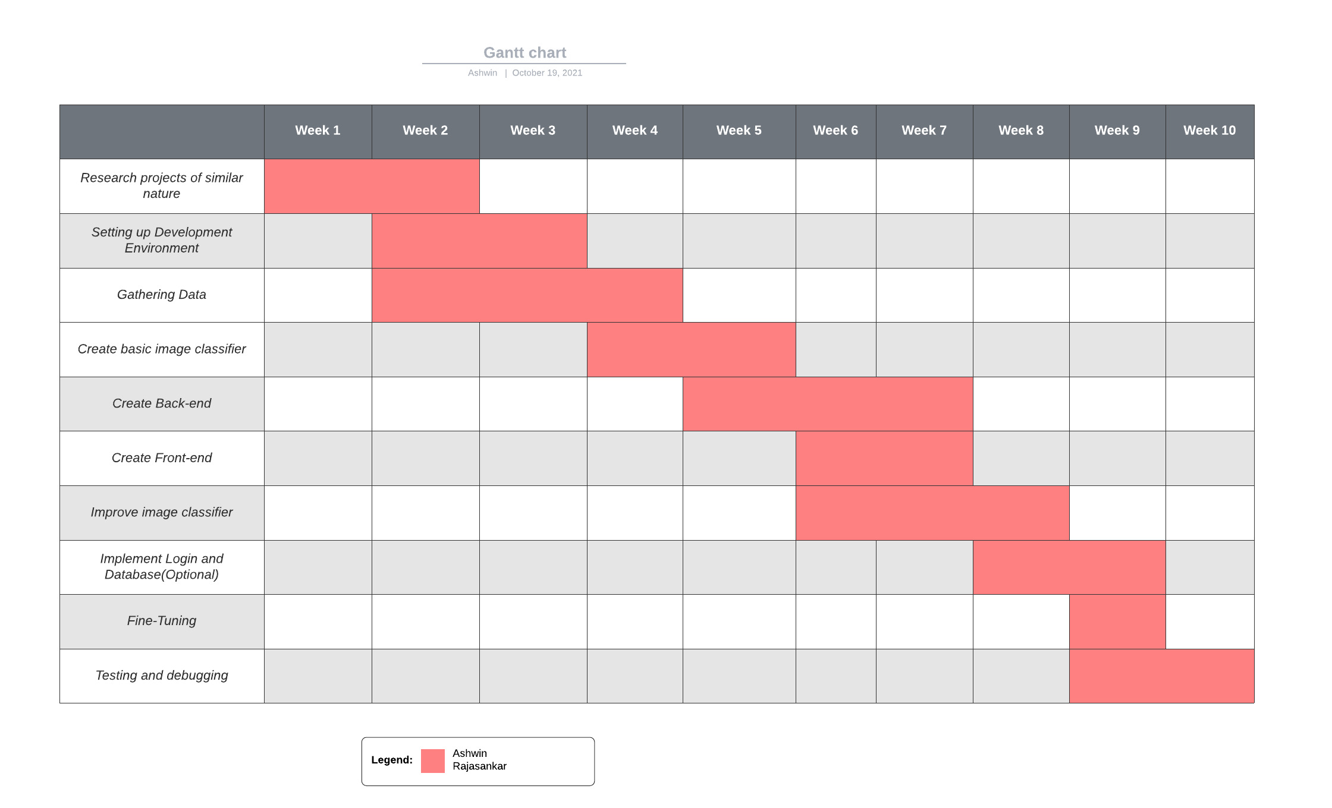
Gantt Chart

Slide 5
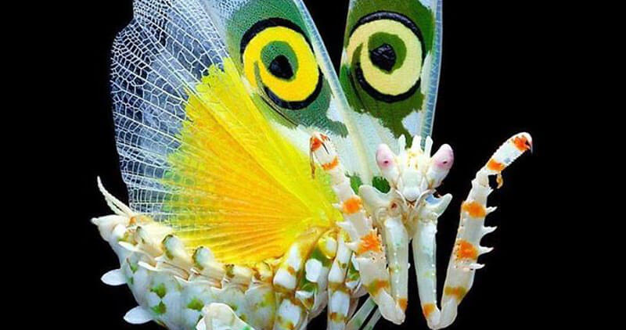
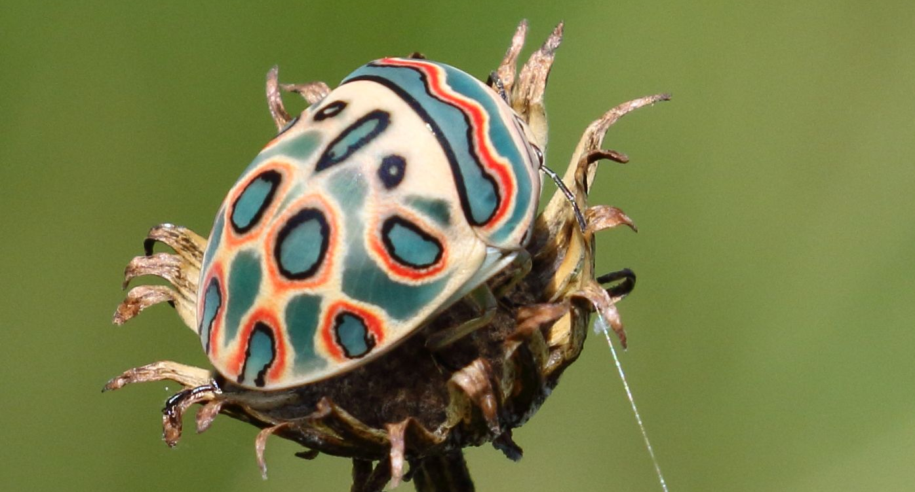
Why?
There are around 900,000 species of insects in the world (80% of world's species).
Identifying them manually is not an easy task for a person who is not an entomologist or doesn't have prior knowledge about insects.
Some insects could destroy entire gardens and fields, if left unchecked.

Slide 6
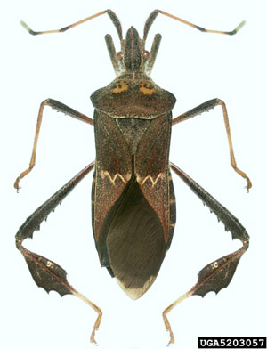
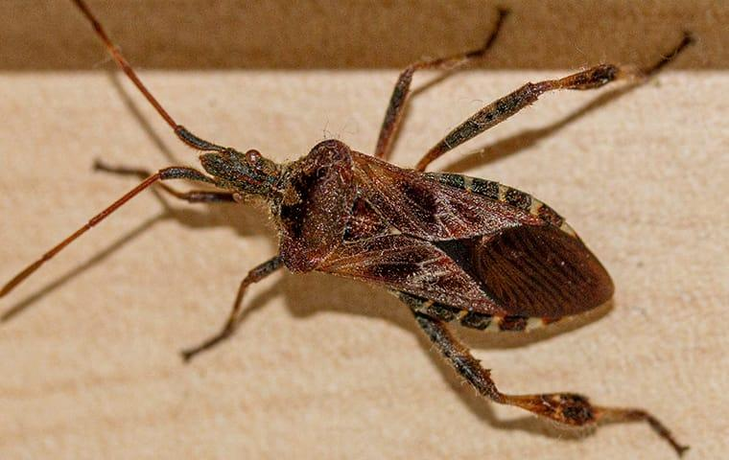
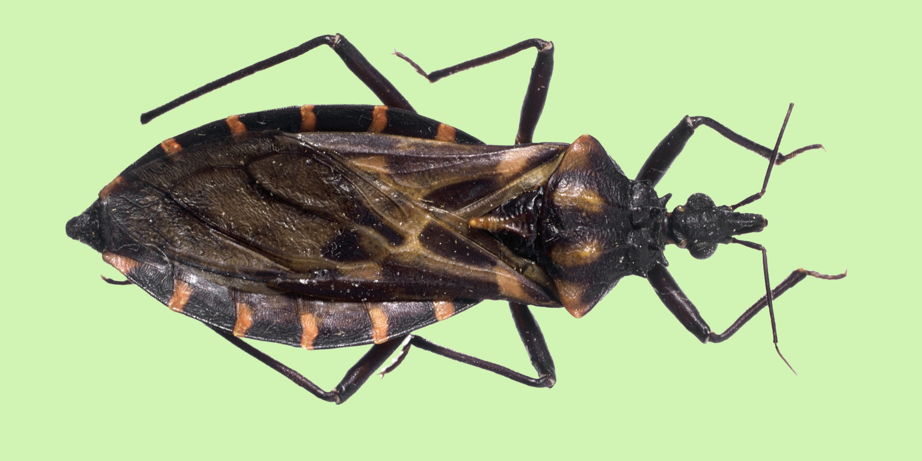
Why?
Spot the difference
Western conifer seed bug
Kissing bug
Leptoglossus zonatus

Slide 7

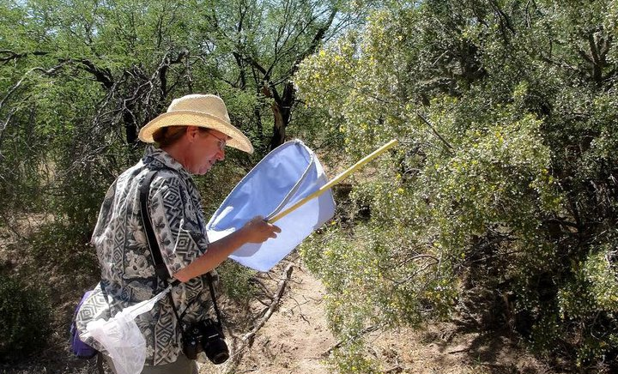

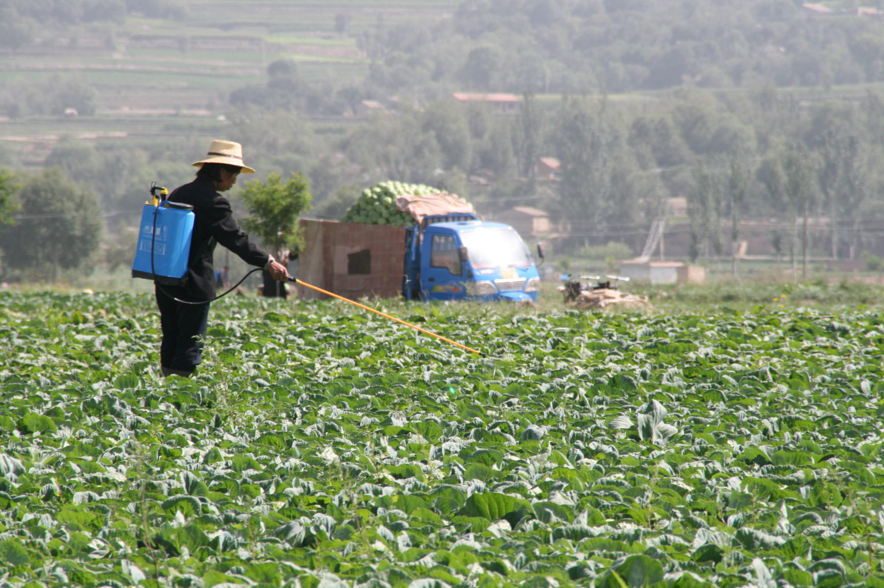
Who?
The project aims to assist farmers, gardeners, bug enthusiasts and nature lovers who want to find the ID of a bug.

Slide 8

Use Case Diagram

Slide 9

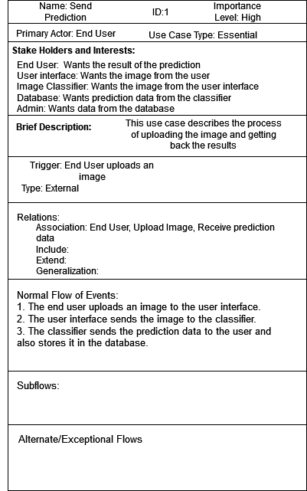
Use Case Description

Slide 10
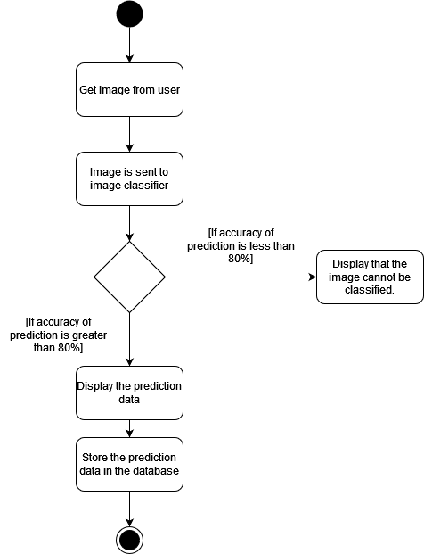
Activity Diagram

Slide 11

THANK YOU!!

